Slide 1
Does India prosper as the number of people being Educated at least at a primary level increase?
Rohith Soman

Slide 2
Dataset
World Development Indicators Dataset

Slide 3
Motivation
Indians are usually considered smart. But still there are a lot of people who are mostly in a backward position in the community who do not have access to even primary education or simply can’t afford it. The Govt has been taking measures to tackle these problems by opening more and more Govt operated schools and provide basic education to the people for free.
So here we are going to analyze if the number of people who at least get a primary education increase, does the country prosper?
Also, in the 70s and 80s, a girl child was considered inferior to a boy child and they were not provided with the same facilities and education which a boy gets. Here we will also see whether the mentality of the people who consider a boy superior to a girl has changed and started to provide equal opportunities of education as time went by.

Slide 4
Research Question
Does India prosper as the number of people being Educated at least at a primary level increase?
Did the mentality of the people who consider a boy superior to a girl has changed and started to provide equal opportunities of education as time went by.

Slide 5
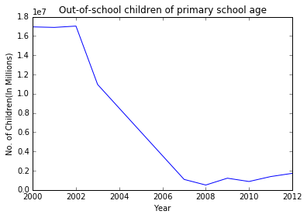
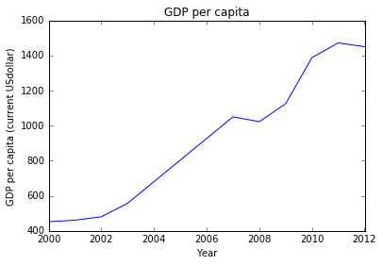
Findings
From these two line charts, we can clearly understand that as the literacy rate of a country increases, the country begin to prosper. We can see from the charts which gives us the details data which ranges over a decade. We can see that up until 2002-2003, the number of kids out of school was a lot and the GDP of India was in a saturated condition. After that we can see that the number of kids out of school comes down and the GDP goes up. So, to conclude, Education gives prosperity.

Slide 6
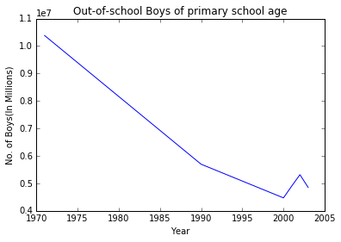
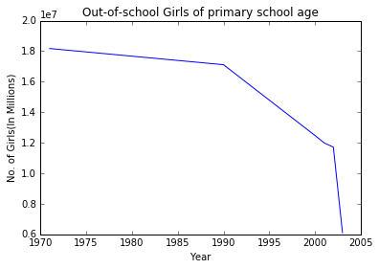
Findings
From these two line charts, we come to know that a girl child was not given the same preferences and education facilities as compared with a boy child until the late 80s. After that we can see a decrease in the number of out of school girls along with the decreasing number in out of school boys. We can see that people’s mentality about a girl child being a burden was slowly changing in the 90s and in the 21st century we can see that people begin to see their children as equal if they are boys or girls and were giving equal opportunities to both. We can conclude that the people’s mentality has changed and they consider their children as gift whether it’s a boy or a girl. A big shout out to women empowerment.

Slide 7
Acknowledgements
Ilkay and Leo for their fantastically designed and taught class.

Slide 8
References
Things I have learned throughout this class
Pandas Documentation https://pandas.pydata.org/pandas-docs/stable/
Matplotlib Documentation https://matplotlib.org/contents.html

